Slide 1

Embedded GarageBand
By: Maulik Kapuria
Niket Shah
Vishal Verma
ECEN-5613
Embedded System Design
Spring 2011

Slide 2
Project Overview
Instruments played are: Piano, Guitar and Drums.
Play MIDI notes using “Real” Instruments and “Virtual” Instruments.
Virtual: They are the instruments created using graphics LCD and touch screen.
Real : They are the instruments that are made using keyboard & piezo buzzers.
Gives the option to select what type of instrument(drum, guitar etc) to play. Also provides an option to select the subtype of a particular instrument (Acoustic Piano, Electric Piano etc)
Record & playback the Notes using an I2C EEPROM.
27th April 2011

Slide 3
Very High Level Block Diagram
Wireless Communication
CC2430
Module 2
CC2430
Module 1
Control & Data Lines
Control & Data Lines
Components & Interfaces
Components & Interfaces
This kind of system was selected since it distributed the strain on peripherals.
The tradeoff was made between
Adding a complex RF communication interface &
Simplifying the design
27th April 2011

Slide 4
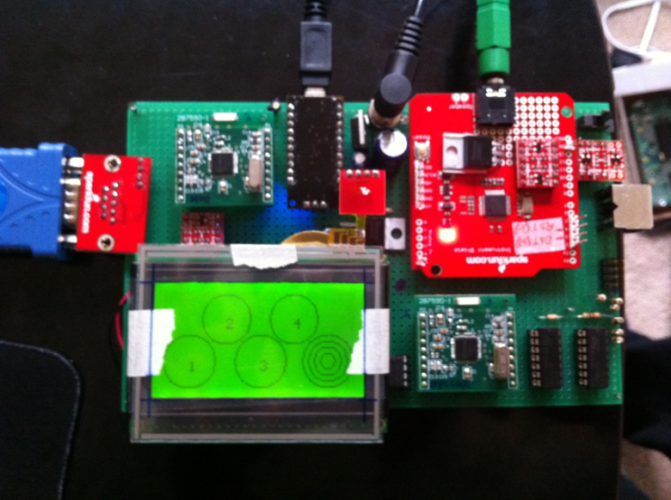
Project Hardware
27th April 2011

Slide 5

Block Diagram
Graphic LCD
128x64 LED Backlight
VS1053 MIDI Decoder
Real Time MIDI Serial
Piezo 1
Serial
Serial
Serial Interface to Computer
Piezo 2
CC2430
Module 2
CC2430
Module 1
Comparator
Piezo 3
RF
RF
Int & Timers
Piezo 4
GPIO
Heart Beat LED
Piezo 5
Serial
I2C
Analog
2 Wire EEPROM
Serial Interface to Computer
Analog
Reference Generator
4-wire
Touch
Screen
Virtual Instrument Pressure Piezo
Note: Components like Oscillator, Logic Converters & Reset Circuit are not shown here
27th April 2011

Slide 6

© http://attemptcreativity.blogspot.com/
27th April 2011

